Slide 1
Methods in Cultural Evolution
Z
X
Y
Part 1 – Introduction to causal inference
Scott Claessens
August 2025
U

Slide 2

Who am I?
I’m Scott Claessens, a researcher in psychology at the University of Kent.

Slide 3
Slides, worksheets, and other materials online at:
https://github.com/ScottClaessens/methods-cultural-evolution

Slide 4
Part 1 – Introduction to causal inference
Part 2 – Spatial and cultural non-independence
Part 3 – Dynamic phylogenetic models

Slide 5
Agenda
Z
What is causal inference?
Structural causal models
Estimating causal effects
Randomised controlled trials
Using observational data
X
Y
U

Slide 6
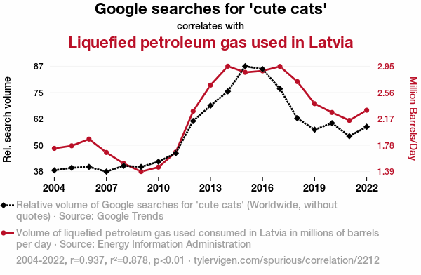

Slide 7
Three scientific questions
Description – what is there?
What is the most-watched show on Netflix?
Prediction – what will happen?
What shows will this Netflix subscriber also enjoy?
Causal inference – what would happen?
How many more Netflix subscribers will we gain if we buy ads?

Slide 8

Assessing the consequences of an intervention
What if I do X?
Assessing a counterfactual outcome
What if I had done X?

Slide 9
Structural causal models
How do variables causally influence one another?
Graphs with arrows connecting different variables
X ← Z → Y
Directed acyclic graphs (DAGs)
Require background knowledge about the system

Slide 10
Wind
Trees

Slide 11
Rain
Wet

Slide 12
Rain
Wet
Wet Shoes
Umbrella

Slide 13
Age
Exercise
Mortality
Diet

Slide 14
Why do randomised controlled trials allow us to uncover causes?

Slide 15
Coin
Age
Exercise
Mortality
Diet

Slide 16
What if we can’t run an experiment?
Unethical e.g., smoking → lung cancer
Impractical or impossible e.g., obesity → heart disease
Retrospective data e.g., no police program → past crime rate
Can we still do causal inference? Yes!

Slide 17
Pipe
X
Z
Y
Fork
X
Z
Y
Collider
X
Z
Y

Slide 18
Pipe
X
Z
Y
Ignoring Z: X and Y are associated
Conditioning on Z: X and Y are not associated
Z closes the path

Slide 19
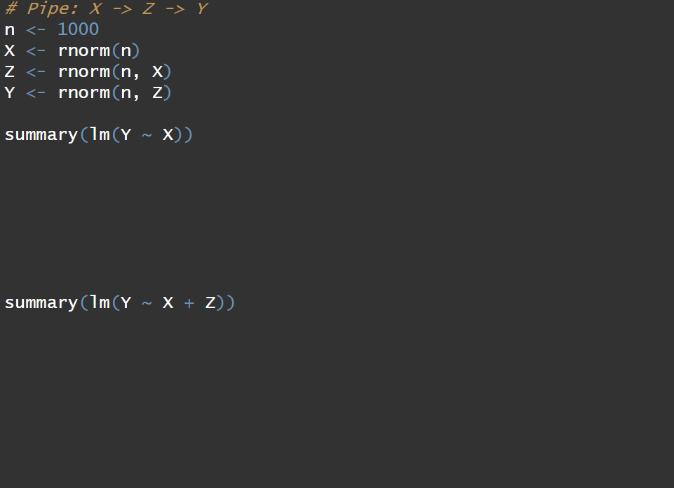
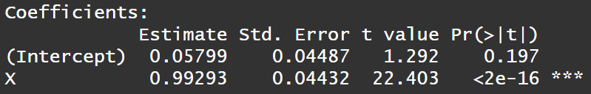
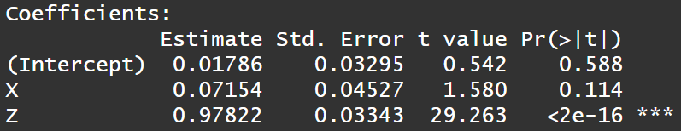

Slide 20
Fork
X
Z
Y
Ignoring Z: X and Y are associated
Conditioning on Z: X and Y are not associated
Z closes the path

Slide 21
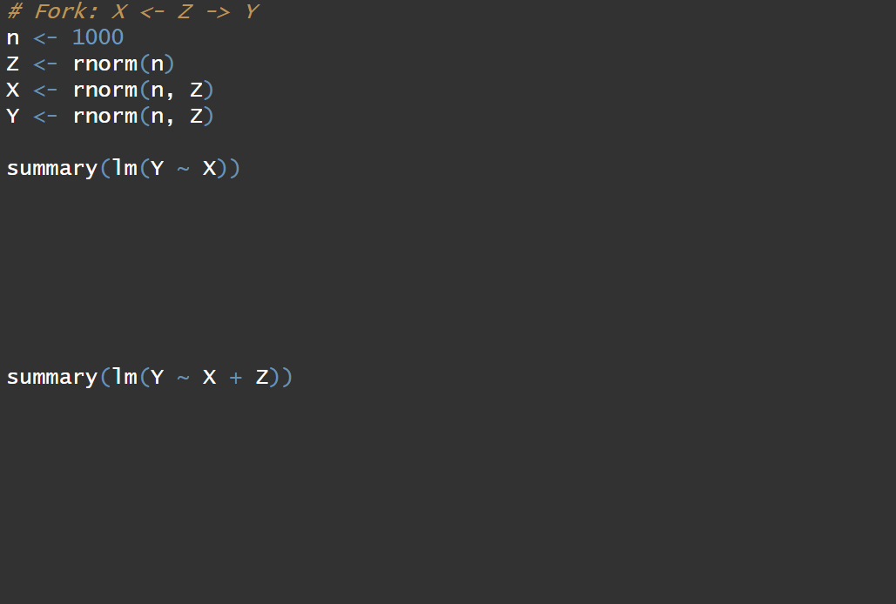
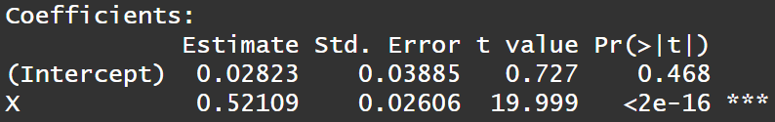
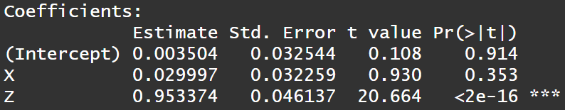

Slide 22
Collider
X
Z
Y
Ignoring Z: X and Y are not associated
Conditioning on Z: X and Y are associated
Z opens the path

Slide 23
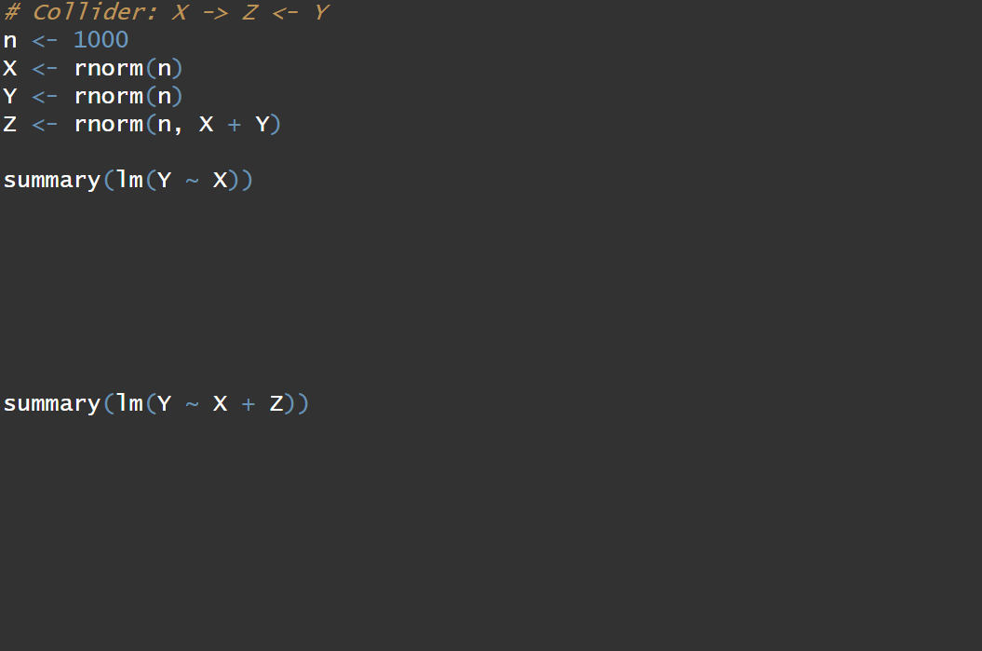
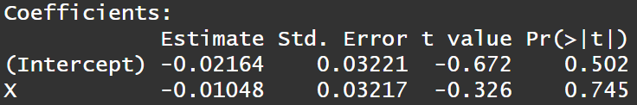
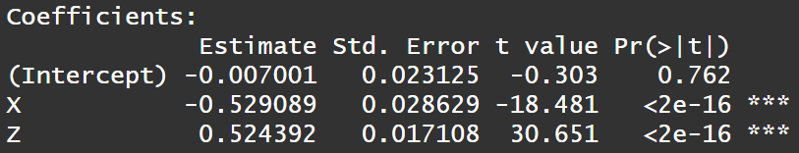

Slide 24

Location
Profit
Food

Slide 25
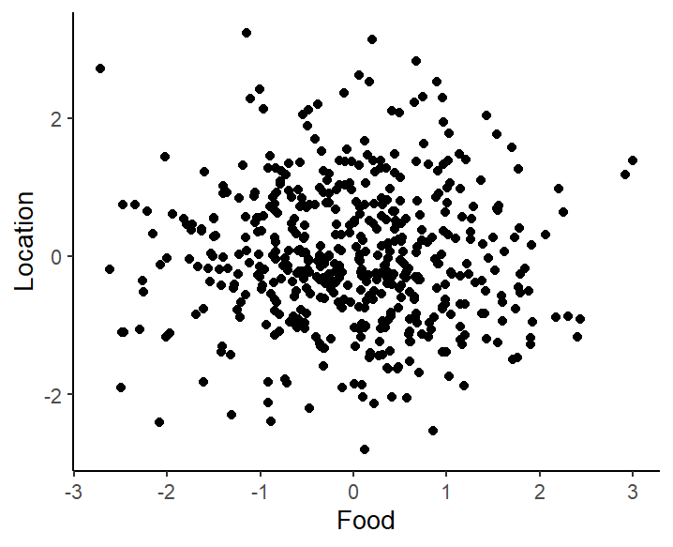

Slide 26
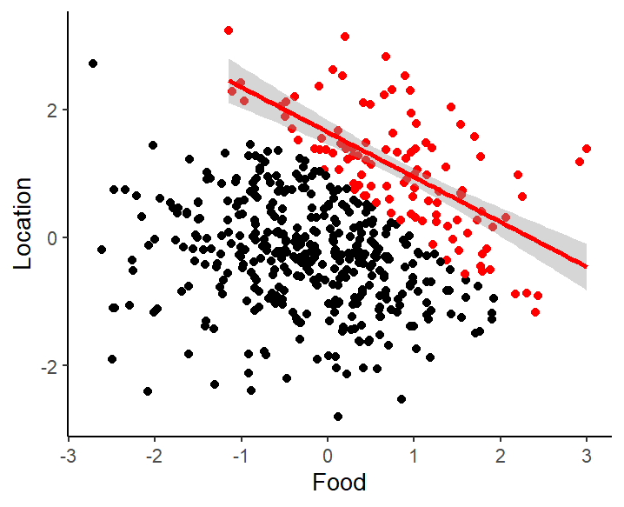

Slide 27
Backdoor criterion
Statistical procedure to estimate causal effects, given set of assumptions in the DAG
Backdoor path = a non-causal path that enters the exposure variable
Goal: Close all backdoor paths!
X
Z
Y
Pipe
Z closes
X
Z
Y
Fork
Z closes
Collider
X
Z
Y
Z opens

Slide 28
Which variables should we control for to estimate the causal effect of X on Y?
A
X
Y
B

Slide 29
Which variables should we control for to estimate the causal effect of X on Y?
A
B
X
Y
C

Slide 30
In summary
Causal inference allows us to assess the effects of interventions – what would happen if I do X?
DAGs can help us draw out causal assumptions
We can use the backdoor criterion to answer causal questions, even when experiments are not feasible
Z
X
Y
U

Slide 31

Further reading
Cinelli, C., Forney, A., & Pearl, J. (2024). A crash course in good and bad controls. Sociological Methods & Research, 53(3), 1071-1104.
Pearl, J., & Mackenzie, D. (2018). The book of why: the new science of cause and effect. Basic books.

